Slide 1
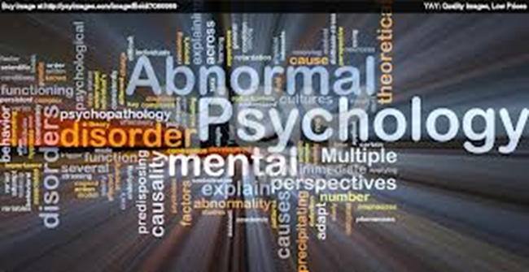
Intro to Abnormal Psych

Slide 2
What is this class about?
What is considered “normal” behavior?
When does behavior cross into becoming “abnormal behavior”?
What exactly is abnormal behavior?
What is “mental” illness and how is it different from other types of illness?
How many people are affected by mental illness?
What are the different types of mental illness?

Slide 3
We don’t know all the answers.
These are the questions that we will be looking at and trying to answer this semester.
However, there are not always clear cut answers and while we know a lot more about mental illness today than we did fifty years ago, there is still much that we do not know .
The study of psychology, and particularly, abnormal psychology, is a relatively new field.
Mental illness has been around for hundreds of years, but an accurate understanding of it has only just begun to take shape in the last several decades and continues to evolve to this day.

Slide 4
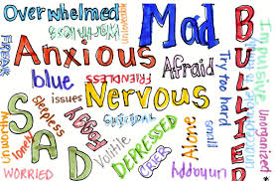
So what is mental illness?
Most simply put, mental illness is a disorder of the brain
Just as cancer or diabetes is a disease of the body, mental illness is a disease of the brain
Unfortunately, in our society, most people don’t look at diseases of the brain and of the body in the same way.

Slide 5
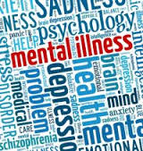
Definition of mental illness
Mental illness refers to a wide range of mental health conditions — disorders that affect your mood, thinking and behavior. Examples of mental illness that we will be talking about it this class include depression, anxiety disorders, schizophrenia, eating disorders and addictive behaviors.

Slide 6
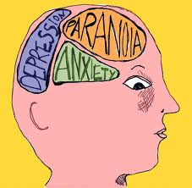
Don’t we all have issues that affect our mood, thinking & behavior?
Many people have mental health concerns from time to time. But a mental health concern becomes a mental illness when ongoing signs and symptoms cause frequent stress and affect your ability to function.

Slide 7
How can mental illness affect your life?
A mental illness can make you miserable and can cause problems in your daily life, such as at work or in relationships.
However, in most cases, symptoms can be managed with a combination of medications and counseling (psychotherapy).

Slide 8
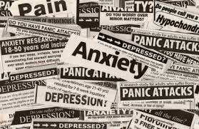
Warning Signs
Signs and symptoms of mental illness can vary, depending on the particular disorder, circumstances and other factors. Mental illness symptoms can affect emotions, thoughts and behaviors.
Examples of signs and symptoms include:
Feeling sad or down
Confused thinking or reduced ability to concentrate
Excessive fears or worries, or extreme feelings of guilt
Extreme mood changes of highs and lows

Slide 9
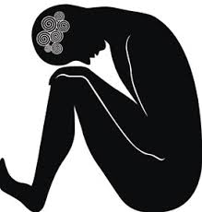
Symptoms of Mental Illness
Withdrawal from friends and activities
Significant tiredness, low energy or problems sleeping
Detachment from reality (delusions), paranoia or hallucinations
Inability to cope with daily problems or stress
Trouble understanding and relating to situations and to people
Alcohol or drug abuse
Major changes in eating habits
Excessive anger, hostility or violence
Suicidal thinking

Slide 10
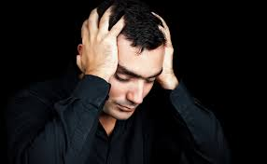
Physical Symptoms
Sometimes symptoms of a mental health disorder appear as physical problems, such as stomach pain, back pain, headache, or other unexplained aches and pains.

Slide 11
When to see a doctor
If you have any signs or symptoms of a mental illness, see your primary care provider or mental health specialist. Most mental illnesses don't improve on their own, and if untreated, a mental illness may get worse over time and cause serious problems.

Slide 12
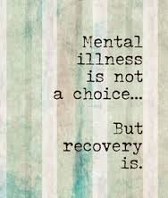
If you have suicidal thoughts
Suicidal thoughts and behavior are common with some mental illnesses. If you think you may hurt yourself or attempt suicide, get help right away:
Call 911 or your local emergency number immediately.
Call a suicide hotline number —the National Suicide Prevention Lifeline at 800-273-TALK (800-273-8255) to reach a trained counselor.

Slide 13
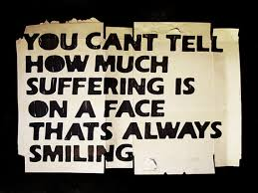
Get Help
Reach out to a close friend or loved one.
Contact a minister or someone in your faith community.
Contact your doctor, other health care provider or mental health specialist like the school’s adjustment counselor.
Suicidal thinking doesn't get better on its own — so get help!

Slide 14
Helping a friend or loved one
If your friend or loved one shows signs of mental illness, have an open and honest discussion with him or her about your concerns. You may not be able to force someone to get professional care, but you can offer encouragement and support. You can also help your loved one find a qualified mental health provider and make an appointment. You may even be able to go along to the appointment.
If your loved one has done self-harm or is seriously considering doing so, take the person to the hospital or call for emergency help.

Slide 15
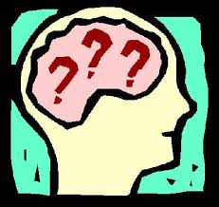
Warning
Just remember that no matter how much you may learn in this class about mental illness, you are not an expert and should not try to take the place of a trained professional.
You may have the best of intentions, but only a licensed psychologist, doctor, or psychiatrist can make a diagnosis and only a trained professional should give medical or therapeutic advice.
Also, don’t fall prey to the “psychology student’s disease” of diagnosing yourself or your friends and family with all of the disorders that we learn about!

Slide 16
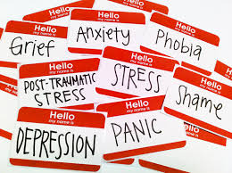
So what causes mental illness?
If mental illness is a disease like any other illness then surely it must have some biological component.
However, it also is affected by other factors, including our life circumstances, our levels of stress, and other external factors.

Slide 17
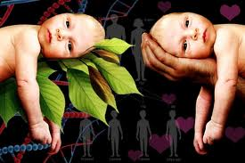
Nature vs Nurture?
You’ve probably heard of the Nature vs Nurture debate
This examines whether our thoughts and behaviors are caused more by biological or environmental factors
Mental illnesses, in general, are thought to be caused by a variety of genetic and environmental factors.
In other words, it is not nature or nurture, but rather a combination of the two.

Slide 18
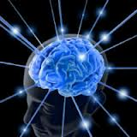
Biological explanation
Says mental illness is caused by genetics, the brain, brain chemicals, hormones or something in the body
Internal causes

Slide 19
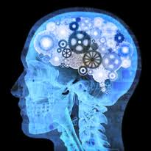
Biological Causes
Inherited traits. Mental illness is more common in people whose biological (blood) relatives also have a mental illness. Certain genes may increase your risk of developing a mental illness.
Brain chemistry. Biochemical changes in the brain are thought to affect mood and other aspects of mental health. Naturally occurring brain chemicals called neurotransmitters play a role in some mental illnesses. In some cases, hormonal imbalances affect mental health.

Slide 20
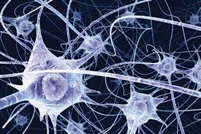
Neurons
Nerve cells in the brain that communicate with one another
In the brains of those with mental illness neurons may misfire or send mixed up signals

Slide 21
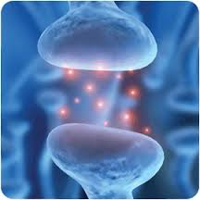
Neurotransmitters
Chemicals in the brain that carry messages between neurons
Examples – dopamine, serotonin

Slide 22
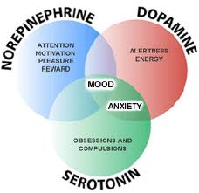
Neurotransmitters
These chemicals are often out of balance in those with mental illness
Psychiatric drugs, like Prozac, attempt to bring these chemicals back into balance

Slide 23
Environmental Causes
Environmental causes include anything outside of yourself (non-biological) that might affect your thoughts and behaviors.
Environmental exposures before birth. Exposure to viruses, toxins, alcohol or drugs while in the womb can sometimes be linked to mental illness.
Environmental exposure after birth. This includes your upbringing, social experiences (in school, etc.), and any traumatic events you may have experienced.
These are all external causes that may contribute to mental illness.

Slide 24
Nature and Nurture
In most cases, mental illness is believed to be caused by a predisposition to mental illness which is triggered by your life situation (stress, traumatic events, etc.)
A predisposition does not mean that you will automatically develop a mental illness, but rather that you are more susceptible because it runs in your family.
For example, depression
- you have a 20% chance of
developing it if it runs in your
family instead of only a 5%
chance if it does not

Slide 25
Who is at risk?
It is important to note that no one is immune from mental illness.
It doesn’t discriminate – anyone, regardless of wealth, gender, or race is vulnerable

Slide 26
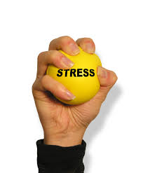
But who is more likely to develop a mental illness?
There are certain groups, however, that possess risk factors making them more prone to develop mental illness:
Having a biological (blood) relative, such as a parent or sibling, with a mental illness
Experiences in the womb — for example, having a mother who was exposed to viruses, toxins, drugs or alcohol during pregnancy
Stressful life situations, such as financial problems, a loved one's death or a divorce
A chronic medical condition, such as cancer

Slide 27
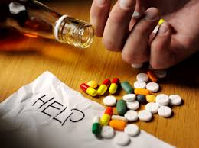
Who else?
Brain damage as a result of a serious injury (traumatic brain injury), such as a violent blow to the head
Traumatic experiences, such as military combat or being assaulted
Use of illegal drugs
Being abused or neglected as a child
Having few friends or few healthy relationships
A previous mental illness

Slide 28
What about gender?
Women are more likely to be diagnosed with mood and anxiety disorders than men
Men are more likely to have substance abuse related disorders and antisocial personality disorder

Slide 29
Can mental illness be treated?
Yes, it can be treated
There is no cure
However, people can live very normal, productive lives with treatment

Slide 30
Historical Treatment
Historically the mentally ill have been treated very poorly
They were beaten, locked up in institutions, and viewed as incapable of being productive and participating members of society

Slide 31
Today’s Treatment
We have come a long way in our treatment of the mentally ill in this country, though we still have a long way to go.
Your treatment today depends on the type of mental illness you have, its severity and what works best for you. In many cases, a combination of treatments works best.

Slide 32
Your Treatment Team
Your treatment team may include your:
Family or primary care doctor
Psychiatrist, a medical doctor who diagnoses and treats mental illnesses
Psychotherapist, such as a psychologist or a licensed counselor
Pharmacist
Social worker
Family members

Slide 33
Psychotherapy
Treatment for many disorders often involves either therapy, medication, or a combination of the two.
Psychotherapy, sometimes just called therapy or counseling, involves talking about your condition and related issues with a mental health provider.
During psychotherapy, you learn about your condition and your moods, feelings, thoughts and behavior. With the insights and knowledge you gain, you can learn coping and stress management skills.

Slide 34
Different Kinds of Therapy
There are many types of psychotherapy, each with its own approach to improving your mental well-being. Psychotherapy often can be successfully completed in a few months, but in some cases, long-term treatment may be needed. It can take place one-on-one, in a group or with family members.

Slide 35
Psychiatric Medication
The use of medication to treat mental illness is known as psychopharmacology
Although psychiatric medications don't cure mental illness, they can often significantly improve symptoms.
Psychiatric medications can also help make other treatments, such as psychotherapy, more effective.
The best medications for you will depend on your particular situation and how your body responds to the medication.

Slide 36
Classes of Psychiatric Medication
The 4 main types of psychiatric meds are antidepressants, anti-anxiety, mood-stabilizing, and antipsychotic medications. Each is designed to treat specific types of disorders and will be talked about later in the semester.

Slide 37
Combination of the Two
The reality is that therapy can be a time consuming process and many people don’t want to put in the effort.
In today’s quick-fix society, many people want to simply pop a pill to make all their problems go away.
While medication can be extremely beneficial and in some cases, even a life-saver, medication alone can not usually “fix” your problems.
Medication will treat the symptoms, but only with therapy can you address the bigger issues.

Slide 38
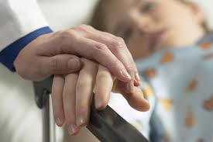
What happens when therapy and medication aren’t enough?
The vast majority of people dealing with mental health issues respond well to medication and/or therapy.
However, some people, do not respond positively to medication, even after trying several different medications.
For a small number of people, their symptoms persist, get worse, or may even lead to suicidal thoughts.
These people may require inpatient treatment.

Slide 39
Inpatient vs. Outpatient
The vast majority of people receiving services for mental health issues are receiving them on an outpatient basis.
The term outpatient is just what it sounds like. You receive treatment out of the hospital. Outpatient services involve going somewhere for therapy or medication.
More serious cases need to be treated on an inpatient basis. This means that you will be hospitalized.

Slide 40
Hospital and Residential Treatment Programs
Sometimes mental illness becomes so severe that you need care in a psychiatric hospital. This is generally recommended when you can't care for yourself properly or when you're in immediate danger of harming yourself or someone else.

Slide 41
Inpatient treatment makes up a very small % of people and most are usually just held for 72 hours to be evaluated.
Options include 24-hour inpatient care, partial or day hospitalization, or residential treatment, which offers a temporary supportive place to live. Another option may be intensive outpatient treatment.

Slide 42
Next Time
Tomorrow we will talk about how common mental illness is (you might be surprised!) and how despite this, there is still a lot of prejudice and discrimination against those who struggle with it daily

Slide 43
The End

