Slide 1
Obsessive Compulsive Disorder (OCD)
And Hoarding Disorder

Slide 2
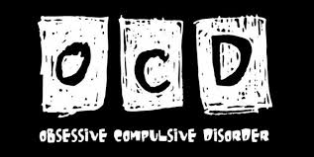
What is Obsessive Compulsive Disorder (OCD)?
Obsessive-compulsive disorder (OCD) is characterized by unreasonable thoughts and fears (obsessions) that lead you to do repetitive behaviors (compulsions).

Slide 3
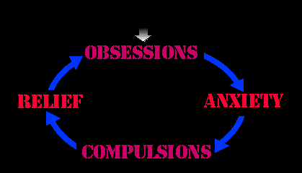
They know it doesn’t make sense, but can’t stop.
With OCD, you may or may not realize that your obsessions aren't reasonable, and you may try to ignore them or stop them.
But that only increases your distress and anxiety. Ultimately, you feel driven to perform compulsive acts in an effort to ease your stressful feelings.

Slide 4
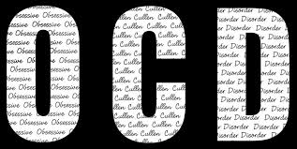
Overwhelming drive
One woman spent hours each evening sifting through the household trash to ensure that nothing valuable was being discarded. When asked what she was looking for, she nervously admitted, "I have no idea, I don't own anything valuable."

Slide 5
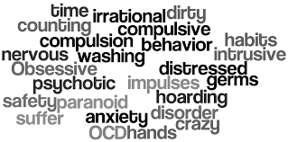
Different types of obsessions
OCD often centers around themes, such as a fear of getting contaminated by germs.
To ease your contamination fears, you may compulsively wash your hands until they're sore and chapped

Slide 6
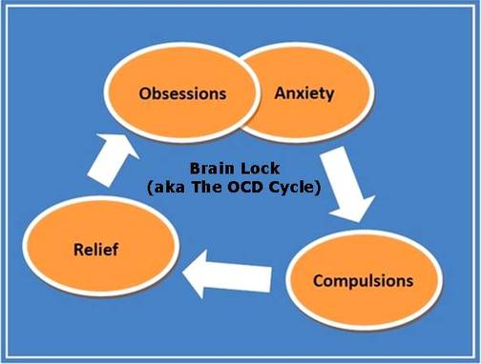
Vicious Cycle
Despite efforts to ignore or get rid of bothersome thoughts, the thoughts or urges keep coming back.
This leads to more ritualistic behavior — and a vicious cycle that's characteristic of OCD.

Slide 7
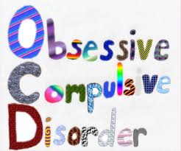
Symptoms
Obsessive-compulsive disorder symptoms usually include both obsessions and compulsions.
But it's also possible to have only obsession symptoms or only compulsion symptoms.
About one-third of people with OCD also have a disorder that includes sudden, brief, intermittent movements or sounds called tics (which we will discuss later this semester).

Slide 8
What are obsessions?
Obsessions are persistent, uncontrollable and unwanted, exaggerated thoughts, worries, or that you can’t get out of your head
– for example, germs, repeated doubts, needing things arranged in a certain way, aggressive impulses, not being able to get images out of your head

Slide 9
Fear of Contamination or Germs
Fear of being contaminated by shaking hands or by touching objects others have touched (doorknobs, etc.)

Slide 10
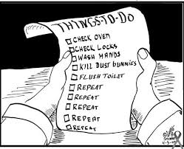
Fearful Doubts
Doubts that you've locked the door or turned off the stove
Can lead to fears that you’ll be robbed or your house will burn down
No matter how much someone reassures you, the doubts never fully go away

Slide 11
Order and Symmetry
Experiencing intense stress when objects aren't orderly or facing a certain way (i.e., marker is upside down in the box)

Slide 12
Aggressive Thoughts or Images
Though you know you would never act them out, you can’t rid your mind of images of hurting yourself or someone else

Slide 13
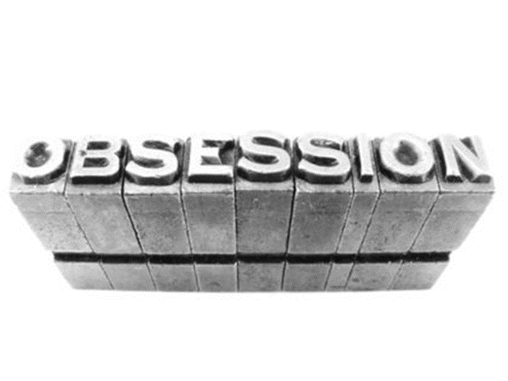
Obscene Thoughts or Images
Thoughts about shouting obscenities or acting inappropriately or
Distress about unpleasant sexual images repeating in your mind
Again, the person would never do it, but knowing the thought is terrible, is what keeps it in your head

Slide 14
What are Compulsions?
Compulsions (also called rituals) are actions that are done to try to stop the obsessions
– for example, repetitive washing/cleaning, checking/seeking reassurance, precisely arranging things

Slide 15
They Don’t Work
These repetitive behaviors are meant to prevent or reduce anxiety related to your obsessions or prevent something bad from happening.
However, engaging in the compulsions brings no pleasure and may offer only a temporary relief from anxiety.

Slide 16
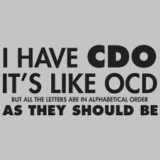
“Rules” You need to Follow
You may also make up rules or rituals to follow that help control your anxiety when you're having obsessive thoughts.
These compulsions are often not rationally connected to preventing the feared event.

Slide 17
As with obsessions, compulsions typically have themes, such as:
Washing and cleaning
Counting
Checking
Demanding reassurances
Following a strict routine
Orderliness

Slide 18
Washing and Cleaning
Hand-washing until your skin becomes raw

Slide 19
Checking
Checking doors repeatedly to make sure they're locked or the stove repeatedly to make sure it's off

Slide 20
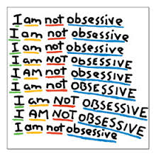
Demanding Reassurances
Having to ask the same question over and over again when anxious about something

Slide 21
Following a Strict Routine
Often taking hours to do things because they need to be done in a very particular and meticulous way
For example, showering, getting dressed, cleaning a room, or packing a suitcase
Will experience extreme anxiety if the routine can not be followed precisely
May try to get family to also follow your routines (though they will likely resist because they see them as bizarre and time-consuming)

Slide 22
Orderliness
Needing to put things in a particular order (“the right way”)
For example, arranging your canned goods to face the same way, books on a shelf may need to be alphabetical, or crayons in the box need to be in order of the rainbow or now upside down.

Slide 23
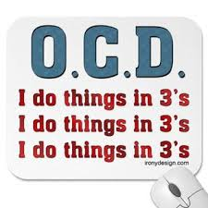
Repeating
Silently repeating a prayer, word or phrase over and over again

Slide 24
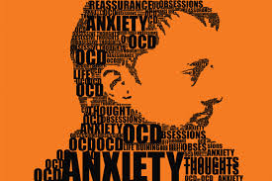
Severity of Symptoms
Symptoms usually begin gradually and tend to vary in severity throughout your life.
Symptoms generally worsen when you're experiencing more stress.
OCD, considered a lifelong disorder, can be so severe and time-consuming that it becomes disabling.

Slide 25
Do they know it doesn’t make sense?
Most adults recognize that their obsessions and compulsions don't make sense, but that's not always the case.
Children may not understand what's wrong.

Slide 26
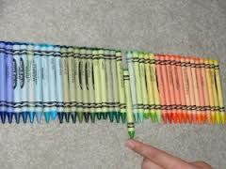
Isn’t this just being a perfectionist?
There's a difference between being a perfectionist and having OCD.
OCD thoughts aren't simply excessive worries about real problems in your life.
Perhaps you keep the floors in your house so clean that you could eat off them. Or you like your knickknacks arranged just so. That doesn't necessarily mean that you have OCD.

Slide 27
When does it become OCD?
If your obsessions and compulsions are affecting your quality of life, then it is time to see your doctor.
Unfortunately, people with OCD may be ashamed and embarrassed about the condition, so often don’t seek out treatment even though it can help.

Slide 28
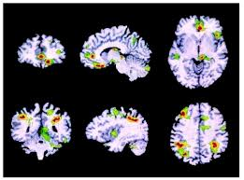
What causes OCD?
The cause of obsessive-compulsive disorder isn't fully understood. Main theories include:
Biology. OCD may be a result of changes in your body's own natural chemistry or brain functions. OCD may also have a genetic component, but specific genes have yet to be identified.
Having parents or other family members with the disorder can increase your risk of developing OCD (predisposition)

Slide 29
Other causes or triggers?
Stressful life events. If you've experienced traumatic or stressful events or you tend to react strongly to stress, your risk may increase. This reaction may, for some reason, trigger the intrusive thoughts, rituals and emotional distress characteristic of OCD.
Environment. Some environmental factors such as infections are suggested as a trigger for OCD, but more research is needed to be sure (there has been suggestion of a link to strep throat)

Slide 30
What additional problems might you have?
Some of the problems below may be associated with OCD — others may exist in addition to OCD but not be caused by it.
Inability to attend work, school or social activities
Troubled relationships
Overall poor quality of life
Anxiety disorders
Depression
Eating disorders
Suicidal thoughts and behavior
Alcohol or other substance abuse
Contact dermatitis from frequent hand-washing

Slide 31
Treatment for OCD
Obsessive-compulsive disorder treatment may not result in a cure, but it can help you bring symptoms under control so they don't rule your daily life. Some people need treatment for the rest of their lives.
The two main treatments for OCD are psychotherapy and medications. Often, treatment is most effective with a combination of these.

Slide 32
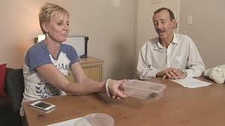
Exposure Therapy
This therapy involves gradually exposing you to a feared object or obsession, such as dirt, and having you learn healthy ways to cope with your anxiety.
Exposure therapy takes effort and practice, but you may enjoy a better quality of life once you learn to manage your obsessions and compulsions.

Slide 33
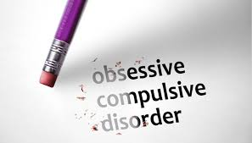
Do Medications work?
Certain psychiatric medications can help control the obsessions and compulsions of OCD. Most commonly, antidepressants are tried first.
Antidepressants that have been approved by the Food and Drug Administration (FDA) to treat OCD include Prozac, Paxil, and Zoloft.

Slide 34
With OCD, it's not unusual to have to try several medications before finding one that works well to control your symptoms.
It can take weeks to months after starting a medication to notice an improvement in your symptoms. Your doctor also might recommend combining medications to make them more effective in controlling your symptoms.
Don't stop taking your medication without talking to your doctor, even if you're feeling better — you may have a relapse of OCD symptoms.
As always, there could be side effects from these drugs.

Slide 35
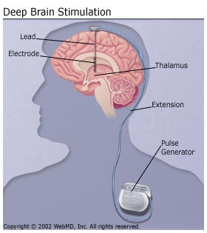
What if those don’t work?
Sometimes, medications and psychotherapy aren't effective enough to control OCD symptoms.
Research continues on the potential effectiveness of deep brain stimulation (DBS) for treating OCD that doesn't respond to traditional treatment approaches.
Because DBS hasn't been thoroughly tested for use in treating OCD, make sure you understand all the pros and cons and possible health risks.

Slide 36
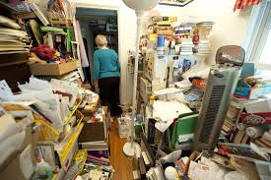
What is hoarding disorder?
Hoarding disorder is a persistent difficulty discarding or parting with possessions because of a perceived need to save them.
A person with hoarding disorder experiences distress at the thought of getting rid of the items. Excessive accumulation of items, regardless of actual value, occurs.

Slide 37
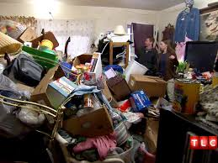
Cramped living conditions
Hoarding ranges from mild to severe.
In severe cases, hoarding often creates such cramped living conditions that homes may be filled to capacity, with only narrow pathways winding through stacks of clutter.

Slide 38
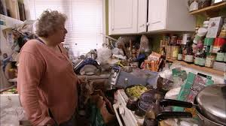
Often don’t see a problem
People with hoarding disorder often don't see it as a problem, making treatment challenging. But intensive treatment can help people with hoarding disorder understand their compulsions and live safer, more enjoyable lives.

Slide 39
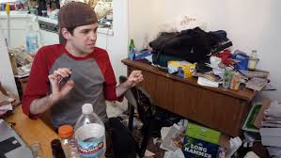
When does it begin?
Clutter and difficulty discarding things are usually the first signs and symptoms of hoarding disorder, which often surfaces during the teenage years.
As the person grows older, he or she typically starts acquiring things for which there is no need or space. By middle age, symptoms are often severe and may be harder to treat.

Slide 40
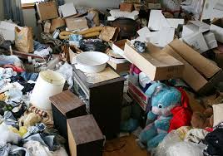
What are the symptoms?
In the homes of people who have hoarding disorder, the countertops, sinks, stoves, desks, stairways and virtually all other surfaces are usually stacked with stuff. And when there's no more room inside, the clutter may spread to the garage, vehicles and yard.

Slide 41
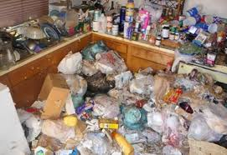
Persistent inability to part with any possession, regardless of its value
Excessive attachment to possessions, including discomfort letting others touch or borrow them or distress at the idea of letting an item go
Cluttered living spaces, making areas of the home unusable for the intended purpose, such as not being able to cook in the kitchen or use the bathroom to bathe
Keeping stacks of newspapers, magazines or junk mail
Letting food or trash build up to unusually excessive, unsanitary levels

Slide 42
Acquiring unneeded or seemingly useless items, such as trash or napkins from a restaurant
Difficulty managing daily activities because of procrastination and trouble making decisions
Moving items from one pile to another, without discarding anything
Difficulty organizing items, sometimes losing important items in the clutter
Shame or embarrassment
Limited or no social interactions

Slide 43
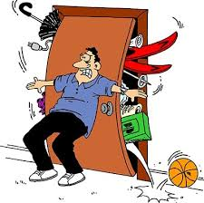
Why do they save all this junk?
They believe these items will be needed or have value in the future
The items have important emotional significance — serving as a reminder of happier times or representing beloved people or pets
They feel safer when surrounded by the things they save

Slide 44
What if you are a collector?
Hoarding disorder is different from collecting.
People who have collections, such as stamps or model cars, deliberately search out specific items, categorize them and carefully display their collections.
Although collections can be large, they aren't usually cluttered and they don't cause the distress and impairments that are part of hoarding disorder.

Slide 45
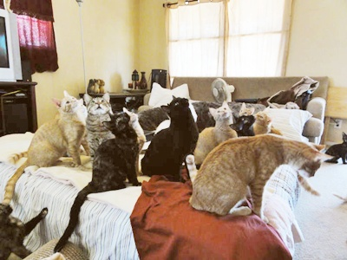
Animal Hoarders
People who hoard animals may collect dozens or even hundreds of pets.
Animals may be confined inside or outside. Because of the large numbers, these animals often aren't cared for properly.

Slide 46
Isn’t this animal cruelty?
The health and safety of the person and the animals are at risk due to unsanitary conditions.
Though this may look like, and even qualify as animal cruelty, animal hoarders usually care very much about their animals and don’t intend them any harm even though they often end up doing just that. Many face animal cruelty charges.
Taking their dozens of cats away from them is as painful, if not more so, as someone taking away your one cat.

Slide 47
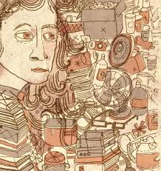
What causes hoarding?
Hoarding has many similarities to OCD and in fact, used to be considered a form of OCD (until the DSM-5)
Like OCD, it's not clear what causes hoarding disorder. Genetics, brain chemistry and stressful life events are being studied as possible causes.

Slide 48
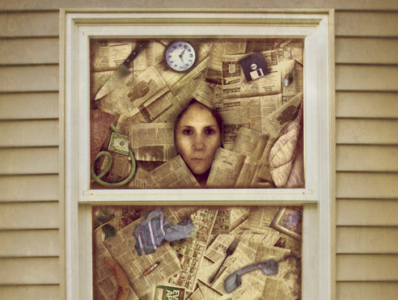
Who is at risk of becoming a hoarder?
Hoarding disorder can affect anyone, regardless of age, sex or economic status.
It's not clear, though, how common hoarding disorder is. That's partly because some people never seek treatment.

Slide 49
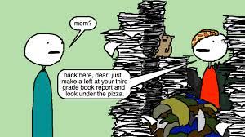
What are the risk factors?
Age. Hoarding usually starts around ages 11 to 15, and it tends to get worse with age. Younger children may start saving items, such as broken toys, pencil nubs, outdated school papers and broken appliances. Hoarding is more common in older adults than in younger adults.
Personality. Many people who have hoarding disorder have a temperament that includes indecisiveness.

Slide 50
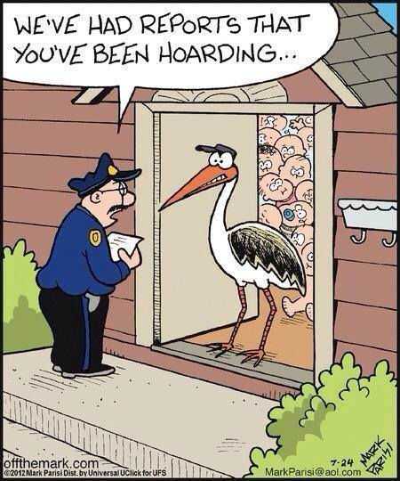
Family history. There is a strong association between having a family member who has hoarding disorder and having the disorder yourself.
Social isolation. People with hoarding disorder are typically socially withdrawn and isolated. In many cases, the hoarding leads to social isolation. But, on the other hand, some people may turn to the comfort of hoarding because they're lonely.

Slide 51
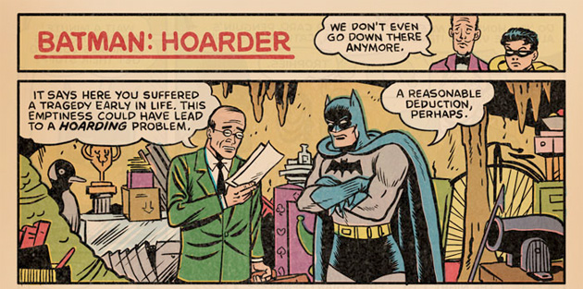
Stressful life events. Some people develop hoarding disorder after experiencing a stressful life event that they had difficulty coping with, such as the death of a loved one, divorce, eviction or losing possessions in a fire.

Slide 52
Treatment
Treatment of hoarding disorder can be challenging because many people don't recognize the negative impact of hoarding on their lives or don't believe they need treatment.
This is especially true if their possessions or animals offer comfort. And people whose possessions or animals are taken away will often quickly collect more to help fulfill emotional needs.

Slide 53
Cognitive Behavioral Therapy (CBT)
Explore why you feel compelled to hoard
Learn to organize and categorize possessions to help you decide which ones to discard
Improve your decision-making and coping skills
Learn and practice relaxation skills

Slide 54
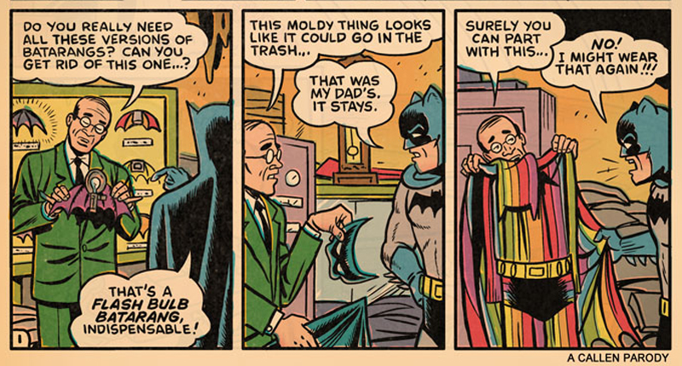
Declutter your home during in-home visits by a therapist or professional organizer

Slide 55
Does medication help?
Although the primary intervention for hoarding disorder is psychotherapy, research continues on the most effective ways to use medications in the treatment of hoarding disorder.
The medications most commonly used are a type of antidepressant called selective serotonin reuptake inhibitors (SSRIs).

Slide 56
Sources
MayoClinic.org
PsychCentral.com

