Slide 1
Self-Injury
Subtitle

Slide 2
What is Self-Injury?
Self-injury, also called self-harm, is the act of deliberately harming your own body, such as cutting or burning yourself.
It's typically not meant as a suicide attempt. Rather, self-injury is an unhealthy way to cope with emotional pain, intense anger and frustration.

Slide 3
Is it a suicide attempt?
Self-harm is not a suicide attempt. In fact, it is an unhealthy coping mechanism that may prevent someone from acting on suicidal thoughts.
However, self-harm can increase the risk of suicide because of the emotional problems that trigger self-injuring.

Slide 4
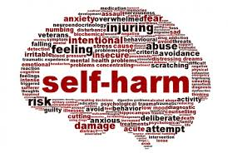
Five Names for Self-Injury
Cutting
Self-abuse
Self-mutilation
Self-inflicted violence
Self-harm

Slide 5
Four common Types of Self-Injury
Cutting (knife, glass, etc…)
Burning (lighter, hot metal, etc…)
Picking (picks at site until a wound is created)
Wound interference (not letting a wound heal)

Slide 6
Characteristics of a Self-Injurer
Difficult to identify because seems like “a normal person”
Normal appearance, good grades, comes from an “average home”
Mostly females

Slide 7
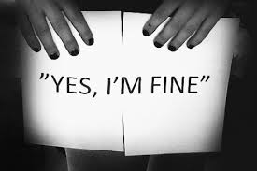
How they keep it secret?
No activities requiring changing clothes in front of others (i.e. gym)
May not have many close friends
Often don’t discuss it with anyone

Slide 8
Six Signs of Self-Injury
Having a knife or lighter for no reason
Do their own laundry
Blood or burn stains inside their clothes
Locks self in the bathroom with water running
Make excuses for injuries
Overly defensive when approached about it

Slide 9
Three Situations NOT Self-Injury
Body decorations / piercings
Spiritual enlightenment
Fitting in or “being cool”

Slide 10
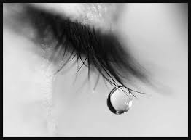
Calm Bad Feeling
While self-injury may bring a momentary sense of calm and a release of tension, it's usually followed by guilt and shame and the return of painful emotions.
After injuring, they still feel bad, but not the panicky trapped feeling – sometimes described as a “calm bad” feeling

Slide 11
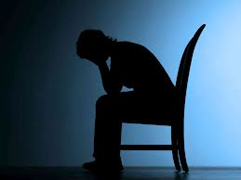
Not a diagnosis
Self-injury is not a diagnosable condition in and of itself, but it is linked to a variety of mental disorders, such as depression, eating disorders and borderline personality disorder.
However, because self-injury is often done impulsively, it can be considered an impulse-control behavior problem.

Slide 12
What causes self-injury?
There's no one single or simple cause that leads someone to self-injure.
In general, self-injury is usually the result of an inability to cope in healthy ways with psychological pain.

Slide 13
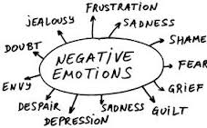
Complex emotions
Self-injurers often have a hard time, expressing or understanding their emotions.
The mix of emotions that triggers self-injury is complex. For instance, there may be feelings of worthlessness, loneliness, panic, anger, guilt, rejection, self-hatred or confused sexuality.

Slide 14
Many reasons why they do it
To manage or reduce severe distress or anxiety and provide a sense of relief
To provide a distraction from painful emotions through physical pain
To feel a sense of control over his or her body, feelings or life situations

Slide 15
Why else do they do it?
To feel something, anything, even if it's physical pain, when feeling emotionally empty
To express internal feelings in an external way
To communicate depression or distress to the outside world
To be punished for perceived faults

Slide 16
Who is most likely to self-injure?
Females. Females are more likely to self-inure than males are.
Teenagers. Most people who self-injure are teenagers and young adults, although those in other age groups also self-injure. Self-injury often starts in the early teen years, when emotions are more volatile and teens face increasing peer pressure, loneliness, and conflicts with parents or other authority figures.
Those with friends who self-injure. People who have friends who intentionally harm themselves are more likely to begin self-injuring.

Slide 17
Life issues. Some people who injure themselves were neglected, or sexually, physically or emotionally abused, or experienced other traumatic events. They may have grown up and still remain in an unstable family environment, or they may be young people questioning their personal identity or sexuality.
Mental health issues. People who self-injure are more likely to be impulsive, explosive and highly self-critical. In addition, self-injury is commonly associated with certain mental disorders, such as borderline personality disorder, depression, anxiety disorders, post-traumatic stress disorder and eating disorders.
Excessive alcohol or drug use. People who harm themselves often do so while under the influence of alcohol or illegal drugs.

Slide 18
Negative effects
Worsening feelings of shame, guilt and low self-esteem
Infection, either from wounds or from sharing tools
Life-threatening problems, such as blood loss if major blood vessels or arteries are cut
Permanent scars or disfigurement
Severe, possibly fatal injury, especially if you harm yourself while under the influence of alcohol or illegal drugs
Worsening of underlying issues and disorders, if not adequately treated

Slide 19
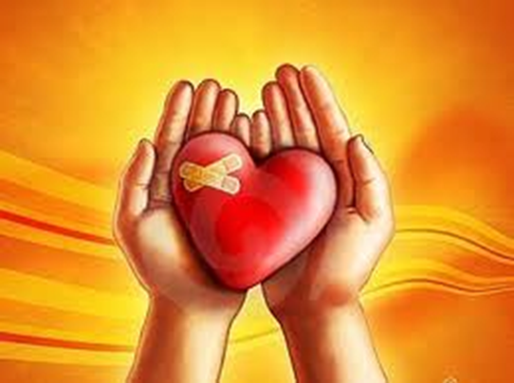
Need new coping strategies
While it may seem logical, it is actually usually a bad idea to encourage someone to discontinue self-harm until healthier coping mechanisms are in place.
Learn by seeing others do it
It may be the only thing preventing them from acting out on suicidal thoughts.

Slide 20
How is self-injury treated?
Treatment can be difficult because self-injurers are often very secretive and unwilling to seek out help
There's no one best way to treat self-injuring behavior, but the first step is to tell someone so you can get help.
Because self-injury can become a major part of your life and it's often accompanied by mental disorders, you may need treatment from a mental health professional experienced in self-injury issues.

Slide 21
Psychotherapy
Therapy can help you identify and manage underlying issues that trigger self-injuring behavior.
Therapy can also help you learn skills to better manage distress, help regulate your impulsiveness and other emotions, and boost your self-image.

Slide 22
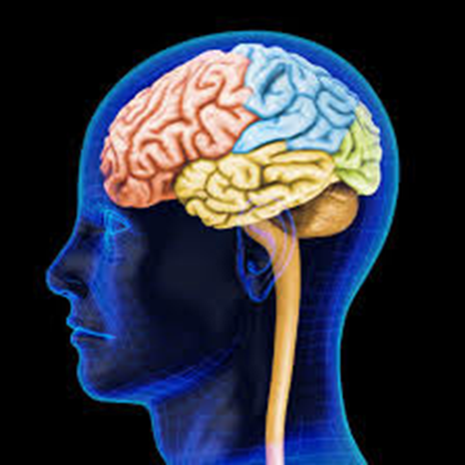
Medication
There are no medications that specifically treat self-injuring behavior.
However, your doctor may recommend treatment with antidepressants or other psychiatric medications to help treat depression, anxiety or other mental disorders commonly associated with self-injury.
Treatment for these disorders may help you feel less compelled to hurt yourself.

Slide 23
Psychiatric Hospitalization
If you injure yourself severely or repeatedly, your doctor may recommend that you be admitted to a hospital for psychiatric care.
Hospitalization, often short term, can provide a safe environment and more intensive treatment until you get through a crisis. Day treatment programs also may be an option.

Slide 24
Sources
MayoClinic.org
PsychCentral.com

