Slide 1
Sleep-Wake disorders

Slide 2
What are sleep disorders?
Sleep disorders are changes in the way that you sleep.
A sleep disorder can affect your overall health, safety and quality of life. Sleep deprivation can affect your ability to drive safely and increase your risk of other health problems.
Some of the signs and symptoms of sleep disorders include excessive daytime sleepiness, irregular breathing or increased movement during sleep, and difficulty falling asleep.

Slide 3
Types of sleep disorders
There are many different types of sleep disorders. They're often grouped into categories that explain why they happen or how they affect you.
Some common types of sleep disorders include: Insomnia, Sleep apnea, Restless legs syndrome (RLS), Narcolepsy, Excessive Daytime Sleepiness, Sleepwalking, Sleep Terrors, and Nightmare Disorder
Most can be treated effectively once they have been correctly diagnosed

Slide 4
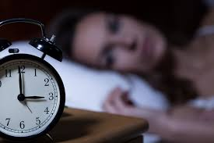
Insomnia disorder
A sleep disorder in which you have difficulty falling asleep or staying asleep throughout the night.
May frequently awaken during the night, have problems falling back asleep when awoken, or wake in the early-morning with the inability to return to sleep
Must occur at least 3 nights per week and be present for at least 3 months
Sleep difficulty occurs despite adequate opportunity for sleep

Slide 5
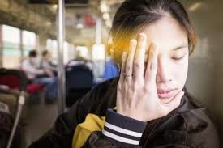
Excessive daytime sleepiness (Hypersomnolence disorder)
Occurs when person self-reports excessive sleepiness (hypersomnolence) despite having slept at least 7 hours
Not feeling refreshed after a full night’s sleep
Symptoms also include recurrent periods of sleep or lapses into sleep within the same day
Difficulty being fully awake after being awakened
At least 3 times/week for at least 3 months

Slide 6
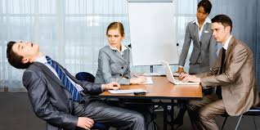
narcolepsy
a condition characterized by falling asleep suddenly during the day (narco means “numbness” and lepsy means “seizure”)
Rare disorder (only 1 in 2,000 people) that starts at puberty and runs in families (if you don’t have it yet you won’t get it)
Experience sleep attacks when their nervous systems become aroused, often from a strong emotion like laughter, crying, or feeling infuriated
When attacks occur, they fall immediately into REM sleep, often at the most inopportune or dangerous times

Slide 7
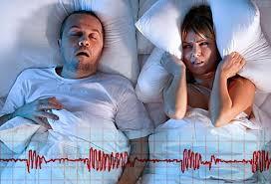
Sleep apnea
A sleep disorder characterized by repeated awakenings throughout the night as a result of not being able to breathe
Person with this is a loud snorer who stops breathing at the peak of a heavy, inhaled snore and whose breathing may cease for as long as a minute
Only way person can breathe again is to briefly awaken
Leaves person feeling exhausted after waking up as many as 400 hundreds times a night (though you don’t remember)

Slide 8
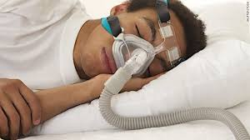
Sleep apnea treatment
Apnea (meaning “with no breath”) sufferers are usually male, overweight, and over 40 – though can affect anyone
Experience dreadful sleepiness even after a full night’s sleep, but may be unaware they are having such poor-quality sleep
Common disorder affecting 4% of population (millions of people)
Most common treatment involves use of a continuous positive airway pressure (CPAP) machine which helps person breathe during the night

Slide 9
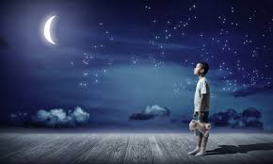
Somnambulism (Aka sleepwalking)
Repeated episodes of rising from bed during sleep and walking about.
While sleepwalking, the person has a blank, staring face, is relatively unresponsive to the efforts of others to communicate with him or her, and can be awakened only with great difficulty because they are in a deep stage of sleep (stage 3 or 4)
Contrary to popular belief the person is not acting out a dream because most dreams occur in REM sleep (not stage 3 or 4)

Slide 10
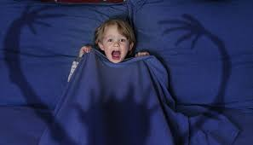
Sleep terrors (or night terrors)
Characterized by high arousal and an appearance of being terrified
Most often afflict children, who look like they are awake and terrified even though they are sound asleep
Child rarely has any memory of the event when told about it in the morning (more frightening to parents who witness it)
Different from nightmares which are dreams and occur during REM sleep – night terrors occurring during Stage 4 sleep

Slide 11
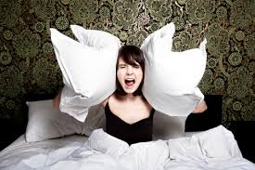
Nightmare disorder
Repeated occurrences of extended, extremely upsetting, and well-remembered dreams that usually involve efforts to avoid threats to survival, security, or physical well-being
Upon awakening, the person rapidly becomes alert and may have rapid breathing, sweating, and show other signs of intense fear
May range from mild (once/week) to severe (nightly)

Slide 12
Other sleep problems
These sleep problems don’t qualify as sleep disorders, but they can be disruptive nonetheless
Bruxism – teeth grinding that sounds as though two bricks are being rubbed together – wear some kind of tooth guard to keep from wearing away enamel
Enuresis – bed wetting
Restless Legs Syndrome – an urge to move the legs due to uncomfortable or unpleasant sensation in the legs
Myoclonus – a sudden jerking of a body part that occurs shortly after falling asleep

