Slide 1
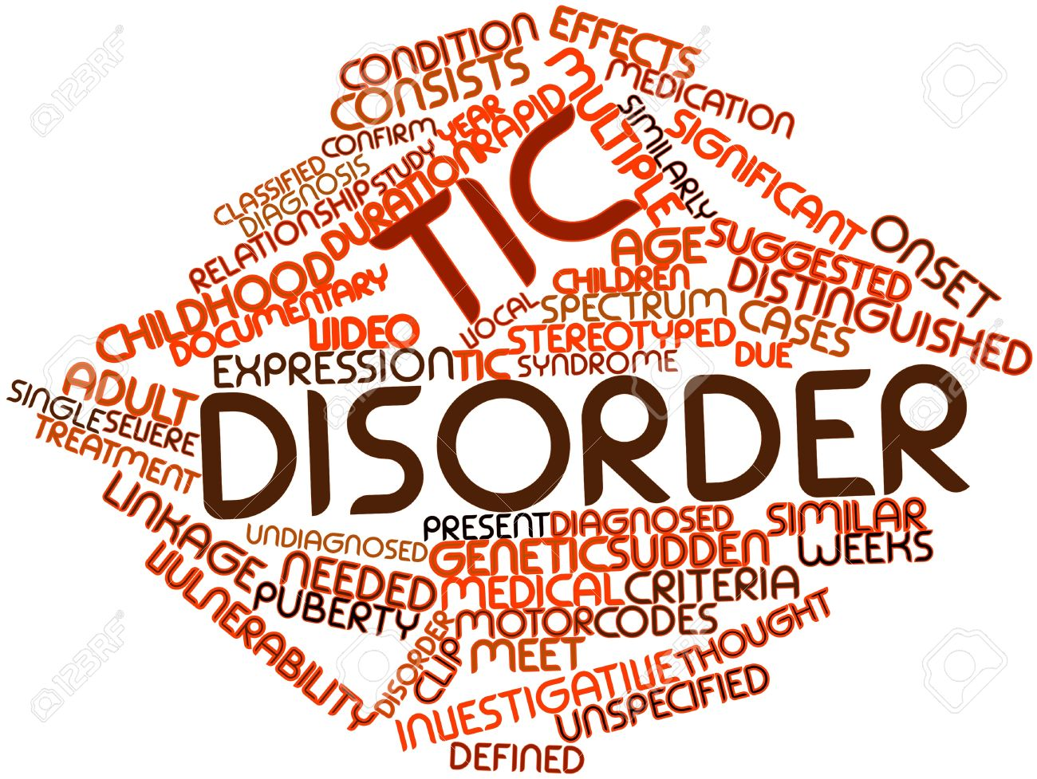
Tourette’s Syndrome

Slide 2
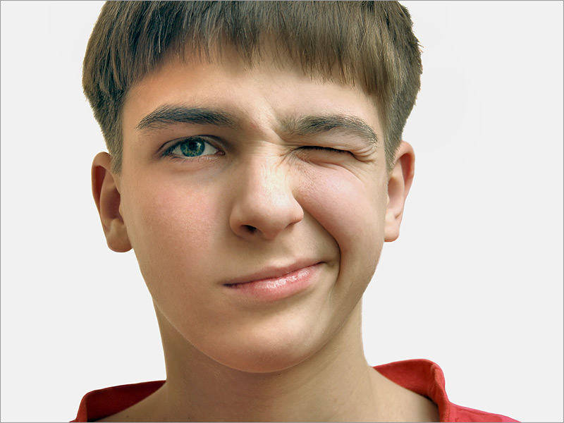
What is a Tic?
A tic is a problem in which a part of the body moves repeatedly, quickly, suddenly and uncontrollably
Tics can occur in any body part, such as the face, shoulders, hands, or legs.
They can be stopped voluntarily for brief periods.

Slide 3
Vocal tics
Sounds that are made involuntarily (such as throat clearing or sniffing) are called vocal tics.
Most tics are mild and hardly noticeable.
However, in some cases they are frequent and severe, and can affect many areas of a child’s life.

Slide 4
Transient tic disorder
The most common tic disorder is called transient tic disorder and may affect up to 10% of children during the early school years.
Teachers or others may notice the tics and wonder if the child is under stress or “nervous”
Transient tics go away by themselves
Some may get worse with anxiety or tiredness

Slide 5
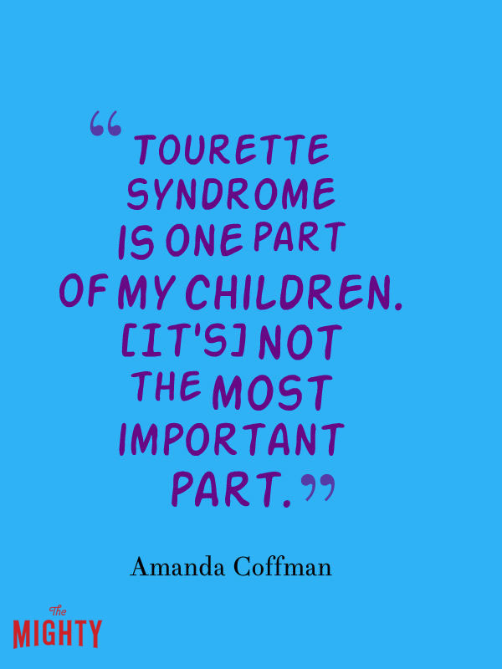
Chronic Tics
Some tics do not go away
Tics which last one year or more are called “chronic tics”
Chronic tics affect less than 1% of children and may be related to a special, more unusual tic disorder called Tourette’s Syndrome

Slide 6
What is Tourette’s?
Though it is often joked about or made fun in the movies, there is actually nothing funny about Tourette’s Syndrome (TS)
TS is a problem with the nervous system that causes people to make sudden movements or sounds (tics) that they can’t control.

Slide 8
For example, someone with TS might blink or clear their throat over and over again. Some people may blurt out words they don’t intend to say.

Slide 10
Not their fault
Sometimes people with TS may blurt out obscene words, insult others, or make obscene gestures or movements.
They cannot control these sounds and movements and should not be blamed for them.

Slide 11
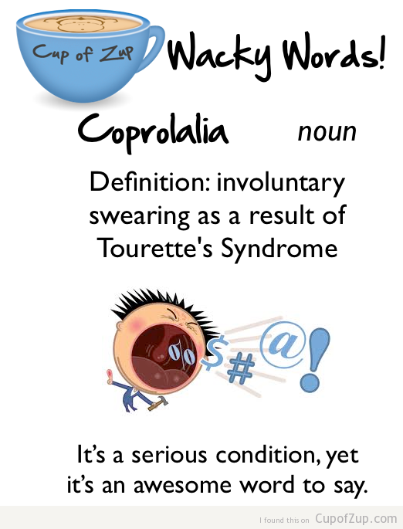
Punishment by parents, teasing by classmates, and scolding by teachers will not help the child to control the tics, but will hurt the child’s self-esteem and increase their distress.

Slide 12
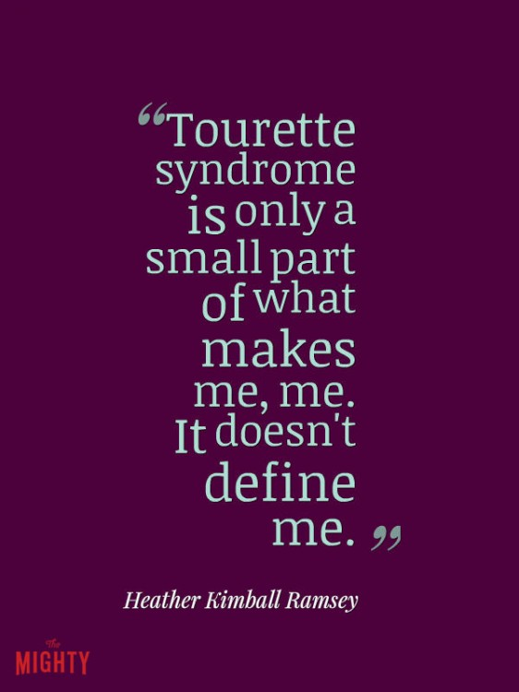
Who gets it?
About 100,000 Americans have full-blown TS, but more people have a milder form of the disease.
More boys than girls get it.
It often starts in childhood, and symptoms often get better as children grow up. For some people, they go away completely.

Slide 13
What Causes TS?
Tourette’s has been linked to different parts of the brain, particularly the area that helps control body movements.
Doctor’s don’t know exactly what causes these problems in the brain, but genes probably play a role. It’s likely that there is more than one cause.
People who have family members with Tourette’s are more likely to get it themselves, but people in the same family may have different symptoms.

