Slide 1
Trauma and Stress-Related Disorders
Adjustment Disorder
Post Traumatic Stress Disorder
Reactive Attachment Disorder

Slide 2
What is psychological trauma?
Psychological trauma is an emotional response to a terrible event like an accident, rape or natural disaster.
Immediately after the event, shock and denial are typical.
Longer term reactions include unpredictable emotions, flashbacks, strained relationships and even physical symptoms like headaches or nausea.

Slide 3
What can trauma lead to?
While these feelings are normal, some people have difficulty moving on with their lives.
This can lead to a psychological disorder such as adjustment disorder or posttraumatic stress disorder.
Psychologists can help these individuals find constructive ways of managing their emotions.

Slide 4
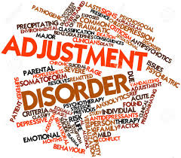
Adjustment Disorder

Slide 5
What is an adjustment disorder?
Work problems, going away to school, an illness – any number of life changes can cause stress. Most of the time, people adjust to such changes within a few months. But if you continue to feel down or self-destructive and have an unusually strong or long-lasting reaction to an upsetting event, then you may have an adjustment disorder.

Slide 6
Anxious? Depressed?
An adjustment disorder is a type of stress-related mental illness. You may feel anxious or depressed, or even have thoughts of suicide. Your normal daily routines may feel overwhelming. Or you may make reckless decisions. In essence, you have a hard time adjusting to change in your life, and it has serious consequences.

Slide 7
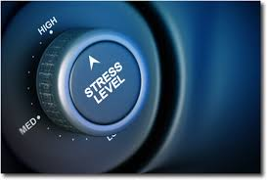
What are the symptoms?
Adjustment Disorder symptoms vary from person to person. The symptoms you have may be different from those of someone else with and adjustment disorder. But for everyone, symptoms of an adjustment disorder begin within 3 months of a stressful event in your life.

Slide 8
Emotional Symptoms
Sadness
Hopelessness
Lack of Enjoyment
Crying Spells
Nervousness/Jitteriness
Anxiety/Worry
Trouble Sleeping
Difficulty Concentrating
Feeling Overwhelmed
Thoughts of suicide

Slide 9
Behavioral Symptoms
Fighting
Reckless driving
Ignoring bills
Avoiding family or friends
Performing poorly in school or at work
Skipping school
Vandalizing property

Slide 10
What causes Adjustment Disorder?
A divorce or relationship breakup
A death in the family
Moving to a new home
Starting a different school
Having a baby
Retirement
Surviving a disaster
A job loss
Financial problems
Physical assault
A big life disappointment

Slide 11
In some cases, people who face an ongoing stressful situation – such as living in a crime-ridden neighborhood can reach a breaking point and develop an adjustment disorder

Slide 12
Isn’t this normal?
While it is normal to experience feelings of sadness and anxiety after events such as these, those with an adjustment disorder experience marked distress, in excess of what would be expected from exposure to the event

Slide 13
Who is at risk?
Like all of the disorders we will discuss this semester, no one is immune from adjustment disorder. However, certain risk factors do make someone more likely to develop an adjustment disorder. Risk factors include:
You generally don’t cope well with change
Lack of a strong support system (friends & family)
If you experiences severe stress in early childhood
Overprotective or abusive parenting

Slide 14
Who else is at higher risk?
Family disruptions or frequent moves early in life may make you feel like you’re unable to control events in your life
Other mental health problems
Exposure to wars or violence
Difficult life circumstances

Slide 15
What qualifies for a diagnosis?
If symptoms occur within 3 months of a stressful event or change, and last no more than 6 months after the stressor ends

Slide 16
What if it lasts longer?
Most adults with adjustment disorder get better within 6 months and don’t have long-term complications. However, people who also have other mental health issues, a substance abuse problem or a chronic adjustment order are more likely to have long-term mental health problems, which may include:
Depression
Alcohol and Drug addiction
Suicidal thoughts and behavior

Slide 17
Teens with Adjustment Disorder
Compared with adults, teens with this disorder – especially chronic adjustment disorder marked by behavioral problems – are at a significantly increased risk of long-term problems.

Slide 18
Other Problems
In addition to depression, substance abuse and suicidal behavior, teenagers are at a risk of developing psychiatric disorders such as:
Schizophrenia
Bipolar Disorder
Antisocial Personality Disorder

Slide 19
When to see a doctor
Sometimes the stressful change in your life goes away, and your symptoms of adjustment disorder get better because the stress has eased. But often, the stressful event remains a part of your life. Or a new stressful situation comes up, and you face the same emotional struggles all over again.
Talk to your doctor if you’re having trouble getting through each day. You can get treatment to help you cope better with stressful events and feel better about life again!

Slide 20
Treatment
Most people find treatment of adjustment disorder helpful, and they often need only brief treatment. Others may benefit from longer treatment. There are 2 main types of treatment for adjustment disorder – psychotherapy and medications

Slide 21
Psychotherapy
The main treatment for adjustment disorders is psychotherapy, also called counseling or talk therapy.
You may attend individual therapy, group therapy, or family therapy.
Therapy can provide emotional support and help you get back to your normal routine.

Slide 22
Therapy can also help you learn why the stressful event affected you so much. As you understand more about this connection, you can learn healthy coping skills to help you deal with other stressful events that may arise.

Slide 23
Medications
In some cases, medications may help, too. Medications can help with such symptoms as depression, anxiety and suicidal thoughts. Antidepressants and anti-anxiety medications are most often used to treat adjustment disorders.

Slide 24
Do what works for you
Sometimes therapy and/or medication are not necessary. Some things you can do to help with an adjustment disorder include:
Talk things over with caring family and friends
Try to keep eating a healthy diet
Stick to a regular sleep routine
Get regular physical activity
Engage in a hobby/activity you enjoy
Find a support group geared toward your situation
Find support from a faith community

Slide 25
Always Consult your Doctor
As with therapy, you may need medications only for a few months, but don’t stop taking any medication without talking with your doctor first. If stopped suddenly, some medications, may cause withdrawal symptoms.

Slide 26
Take control of Your Life
When you face a stressful event or major life change, take steps to care for your emotional well-being. Talking about your feelings and asking for help is important to aid your recovery from an adjustment disorder or any of the disorders we will discuss this semester.

Slide 27
Post-Traumatic Stress Disorder (PTSD)
Post-traumatic stress disorder (PTSD) is a mental health condition that's triggered by a terrifying event - either experiencing it or witnessing it.
Symptoms may include flashbacks, nightmares and severe anxiety, as well as uncontrollable thoughts about the event.

Slide 28
Adjustment Disorder vs. PTSD
Many people who go through traumatic events have difficulty adjusting and coping for a while, but don't have PTSD - with time and good self-care, they usually get better.
But if the symptoms get worse or last for months or even years and interfere with your functioning, you may have PTSD.

Slide 29
What are the symptoms of PTSD?
Post-traumatic stress disorder symptoms may start within three months of a traumatic event, but sometimes symptoms may not appear until years after the event.
These symptoms cause significant problems in social or work situations and in relationships.

Slide 30
4 Types of Symptoms
PTSD symptoms are generally grouped into four types: intrusive memories, avoidance, negative changes in thinking and mood, or changes in emotional reactions.

Slide 31
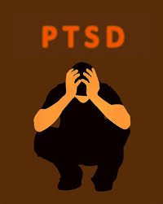
Intrusive Memories
Symptoms of intrusive memories may include:
Recurrent, unwanted distressing memories of the traumatic event
Reliving the traumatic event as if it were happening again (flashbacks)
Upsetting dreams about the traumatic event
Severe emotional distress or physical reactions to something that reminds you of the event

Slide 32
Avoidance
Symptoms of avoidance may include:
Trying to avoid thinking or talking about the traumatic event
Avoiding places, activities or people that remind you of the traumatic event

Slide 33
Negative Changes in Thinking & Mood
Negative feelings about yourself or other people
Inability to experience positive emotions
Feeling emotionally numb
Lack of interest in activities you once enjoyed
Hopelessness about the future
Memory problems, including not remembering important aspects of the traumatic event
Difficulty maintaining close relationships

Slide 34
Changes in Emotional Reactions
Irritability, angry outbursts or aggressive behavior
Always being on guard for danger
Overwhelming guilt or shame
Self-destructive behavior, such as drinking too much or driving too fast
Trouble concentrating
Trouble sleeping
Being easily startled or frightened

Slide 35
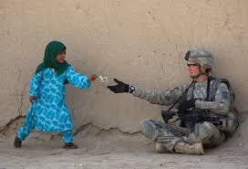
What triggers the symptoms?
PTSD symptoms can vary in intensity over time. You may have more PTSD symptoms when you're stressed in general, or when you run into reminders of what you went through.
For example, you may hear a car backfire and relive combat experiences. Or you may see a report on the news about a sexual assault and feel overcome by memories of your own assault.

Slide 36
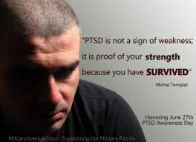
When is it time to get help?
If you have disturbing thoughts and feelings about a traumatic event for more than a month, if they're severe, or if you feel you're having trouble getting your life back under control, talk to your health care professional. Get treatment as soon as possible to help prevent PTSD symptoms from getting worse.

Slide 37
What causes PTSD?
You can develop post-traumatic stress disorder when you go through, see or learn about an event involving actual or threatened death, serious injury or sexual violation.
Doctors aren't sure why some people get PTSD. As with most mental health problems, PTSD is probably caused by a complex mix of several factors:

Slide 38
Why some and not others?
Having biological (blood) relatives with mental health problems, including PTSD or depression
Life experiences, including the amount and severity of trauma you've gone through since early childhood
Inherited aspects of your personality — often called your temperament
The way your brain regulates the chemicals and hormones your body releases in response to stress

Slide 39
Other Risk Factors
Experiencing intense or long-lasting trauma
Having experienced other trauma earlier in life, including childhood abuse or neglect
Having a job that increases your risk of being exposed to traumatic events, such as military personnel and first responders
Having other mental health problems, such as anxiety or depression
Lacking a good support system of family and friends

Slide 40
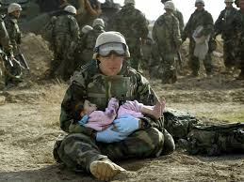
What kinds of traumatic events lead to PTSD?
The most common events leading to the development of PTSD include:
Combat exposure
Childhood neglect and physical abuse
Sexual assault
Physical attack
Being threatened with a weapon

Slide 41
Other types of traumatic events
Many other traumatic events also can lead to PTSD, such as fire, natural disaster, mugging, robbery, car accident, plane crash, torture, kidnapping, life-threatening medical diagnosis, terrorist attack, and other extreme or life-threatening events.

Slide 42
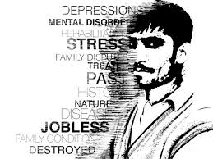
Effect on your daily life
Post-traumatic stress disorder can disrupt your whole life: your job, your relationships, your health and your enjoyment of everyday activities.

Slide 43
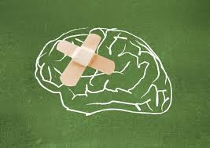
Other Mental Health problems
Having PTSD also may increase your risk of other mental health problems, such as:
Depression and anxiety
Issues with drugs or alcohol use
Suicidal thoughts and actions

Slide 44
What kinds of treatment can help with PTSD?
Post-traumatic stress disorder treatment can help you regain a sense of control over your life. The primary treatment is psychotherapy, but often includes medication.

Slide 45
What kinds of therapy?
Cognitive therapy. This type of talk therapy helps you recognize the ways of thinking (cognitive patterns) that are keeping you stuck - for example, negative or inaccurate ways of perceiving normal situations. For PTSD, cognitive therapy often is used along with exposure therapy.

Slide 46
Exposure Therapy
Exposure therapy helps you safely face what you find frightening so that you can learn to cope with it effectively. One approach to exposure therapy uses "virtual reality" programs that allow you to re-enter the setting in which you experienced trauma.

Slide 47
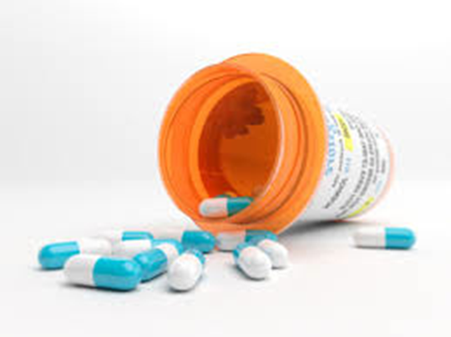
Medication
Antidepressants, Anti-anxiety medication, as well as drugs to help you sleep (if experiencing insomnia and recurrent nightmares) may all be prescribed to help with PTSD.

Slide 48
Taking Care of Yourself
With or without therapy and medication, it is important to take steps to take care of yourself if you have PTSD.
This may include exercise, seeking out others who will listen, joining a support group, and not self-medicating (turning to drugs or alcohol to numb your feelings)

Slide 49
What is Reactive Attachment Disorder (RAD)?
Reactive attachment disorder (RAD) is a rare but serious condition in which an infant or young child doesn't establish healthy attachments with parents or caregivers.

Slide 50
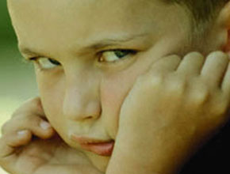
Reactive attachment disorder may develop if the child's basic needs for comfort, affection and nurturing aren't met and loving, caring, stable attachments with others are not established.

Slide 51
RAD in early childhood
Reactive attachment disorder (RAD) can start in infancy.
There's little research on signs and symptoms of RAD beyond early childhood, and it remains uncertain whether it occurs in children older than 5 years.

Slide 52
Signs & Symptoms of RAD
Withdrawal, fear, sadness or irritability that is not readily explained
Sad and listless appearance
Not seeking comfort or showing no response when comfort is given
Failure to smile

Slide 53
Watching others closely but not engaging in social interaction
Failing to ask for support or assistance
Failure to reach out when picked up
No interest in playing peekaboo or other interactive games

Slide 54
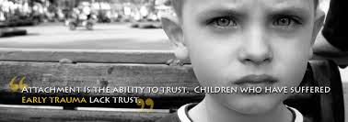
Can be confused with ASD
Reactive attachment disorder is rare.
Signs and symptoms can occur in children who don't have reactive attachment disorder or who have another disorder such as autism spectrum disorder.

Slide 55
What causes RAD?
To feel safe and develop trust, infants and young children need a stable, caring environment. Their basic emotional and physical needs must be consistently met.
For instance, when a baby cries, his or her need for a meal or a diaper change must be met with a shared emotional exchange that may include eye contact, smiling and caressing.

Slide 56
Emotional Needs not Met
A child whose needs are ignored or met with a lack of emotional response from caregivers does not come to expect care or comfort or form a stable attachment to caregivers.

Slide 57
Are some babies just more resilient?
Most children are naturally resilient, and even those who've been neglected, lived in orphanages or had multiple caregivers can develop healthy relationships. It's not clear why some babies and children develop reactive attachment disorder and others don't.

Slide 58
A lot more needs to be learned
Various theories about RAD and its causes exist, and more research is needed to develop a better understanding and improve diagnosis and treatment options.

Slide 59
So what kids are most at risk?
The risk of developing reactive attachment disorder from serious social and emotional neglect or the lack of opportunity to develop stable attachments may increase in children who:
Live in a children's home or other institution
Frequently change foster homes or caregivers
Have inexperienced parents

Slide 60
Have prolonged separation from parents or other caregivers due to hospitalization
Have a mother with postpartum depression
Are part of an unusually large family, such that parental time is scarce or available unequally or rarely

Slide 61
Despite this…
However, most children who are severely neglected don't develop reactive attachment disorder.

Slide 62
Treatment for RAD
Children with RAD are believed to have the capacity to form attachments, but this ability has been compromised by their experiences.
The best treatment for a child with reactive detachment disorder is a positive, loving, stable, caring environment and caregiver.

Slide 63
Sources
Psych Central.com
Mayo Clinic.org
American Psychological Association.org

